Slide 1


Lane Detection Based on Deep Learning
By Taojie Wang and Mengxuan Wu

Slide 2

01
Introduction

Slide 3

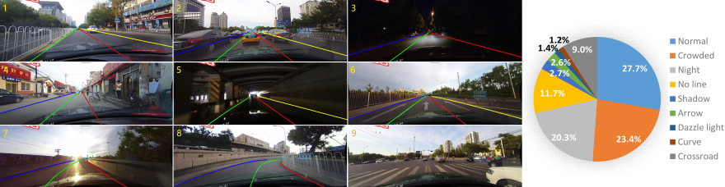
Introduction
Lane Detection
Notes:
Lane detection is a crucial component of autonomous driving systems, as it provides information for vehicle control, path planning, and decision-making, which are essential for safe and efficient driving.
It is a challenging task due to the complex road conditions and the diversity of lane markings. The goal is to accurately detect and track the lane markings in real-time, even under challenging conditions such as poor lighting, occlusions, and varying road surfaces.

Slide 4
02
Related Work

Slide 5
Datasets
CULane Dataset
Notes:
CULane is a large scale challenging dataset for academic research on traffic lane detection.
Collected by cameras mounted on six different vehicles driven by different drivers in Beijing.
More than 55 hours of videos were collected and 133,235 frames were extracted.

Slide 6
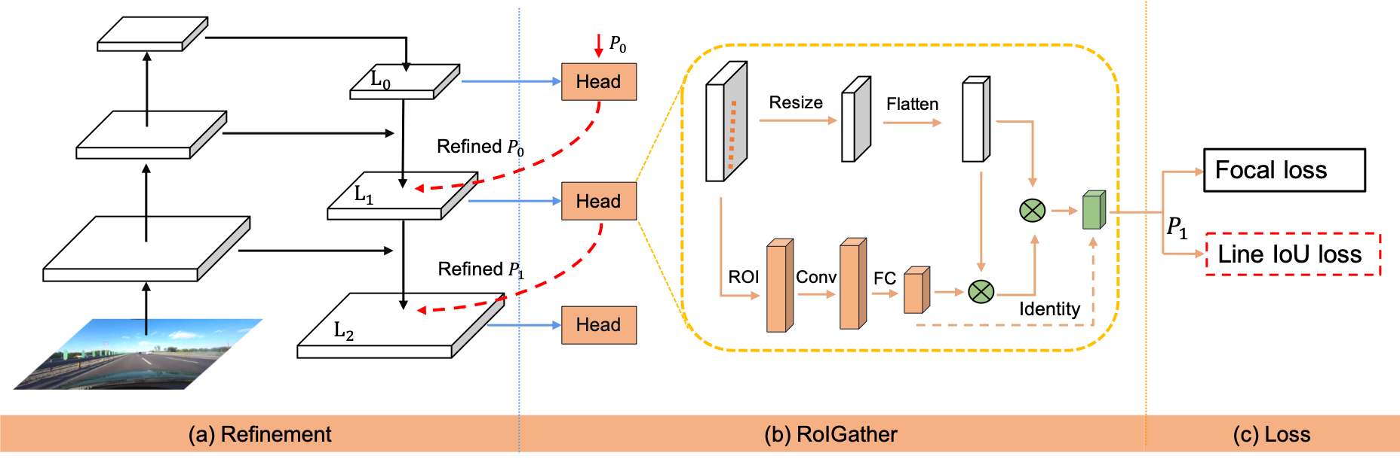
Models
CLRNet: Current SOTA on LLAMAS Dataset

Slide 7
Models
CLRNet: Anchor Refine
Anchor:
Positive & negative scores
x, y coordinates
Angle wrt. X axis
Length of lane
Offsets of 72 points

Slide 8
Models
CLRNet: Anchor Refine
Anchor:
Positive & negative scores
x, y coordinates
Angle wrt. X axis
Length of lane
Offsets of 72 points
$$L$$
$$Θ$$
$$(x, y)$$

Slide 9
Models
CLRNet: Anchor Refine
Anchor:
Positive & negative scores
x, y coordinates
Angle wrt. X axis
Length of lane
Offsets of 72 points

Slide 10
Models
PANet: 1st in COCO Instance Segmentation Challenge 2017

Slide 11
03
Completed Work

Slide 12
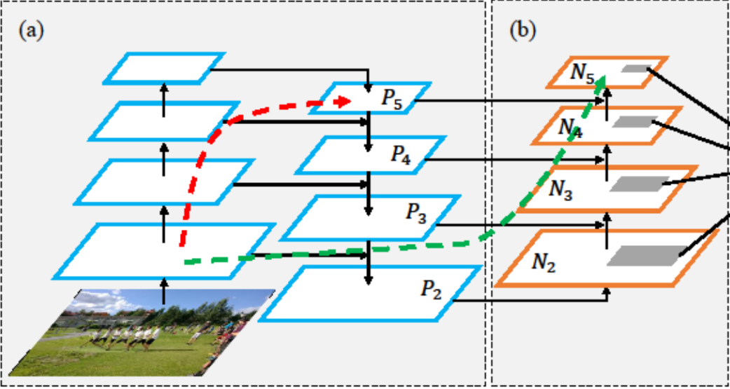
Novelty
Replace FPN with PAFPN
Notes:
即通过将原有的 Feature Pyramid Network (FPN) 替换为 Path Aggregation Feature Pyramid Network (PAFPN)，来提升 CLRNet 模型在车道检测中的性能。以下是你可以详细讲解的内容框架：
你们的创新是在现有的深度学习模型（CLRNet）基础上，提出一种新的网络架构改进，通过替换特征提取部分的 FPN 为 PAFPN，从而提升车道检测系统的准确性和鲁棒性。
1. CLRNet中的FPN架构
在此之前，CLRNet（Cross Layer Refinement Network）采用了 Feature Pyramid Network (FPN) 来进行特征提取。
FPN 的核心思想是通过不同层次的卷积特征来捕捉图像中不同尺度的物体信息。
FPN的工作原理：
FPN是一种特征金字塔网络，它将不同分辨率的特征图（从高层到低层）进行自顶向下的融合，以此增强模型对不同尺度物体的识别能力。
通过在每一层生成多尺度特征，FPN能够处理具有不同空间尺寸和复杂度的对象，比如道路标线。
它的特征融合过程往往会忽略低层次特征与高层次特征之间的信息流动，导致特征信息的丢失，影响检测结果的精度。
2. Path Aggregation Feature Pyramid Network (PAFPN)
为了解决这些问题，我们提出将 FPN 替换为 PAFPN，PAFPN 是从 PANet（Path Aggregation Network）衍生出来的一种网络结构，具有更强的路径增强功能。
PAFPN的创新与优势：
路径增强：PAFPN通过加入额外的“路径增强”模块来进一步优化特征融合。具体来说，它不仅在不同层之间进行自顶向下的特征融合，还通过增强低层特征的路径，改善低层次特征对高层次特征的影响，从而提升特征提取的效果。
路径增强模块：PAFPN在FPN的基础上，增加了一个额外的从底层到顶层的增强路径，使得低层特征能在更深的网络中得到更多关注。这是为了避免在网络深层丢失低层次的细节信息（例如道路标线的局部细节），提升对小物体的检测能力。
融合低级与高级特征：PAFPN不仅对低层特征进行了增强，还通过优化路径使低层特征与高级特征的结合更加紧密。

Slide 13
Results
Model | Precision | Recall | F1 | FPS
Baseline | 86.26 | 72.46 | 78.76 | 309
Ours | 86.39(+0.13) | 72.97(+0.51) | 79.11(+0.35) | 289(-6.5%)
Notes:
为了验证这一创新的有效性，我们将通过实验来评估替换FPN为PAFPN后，模型在实际车道检测中的表现。
精度提升：实验结果表明，使用PAFPN的模型在车道检测的精度、召回率和F1分数上都有明显提升。例如，在CULane数据集上，精度从86.26%提升到86.39%，召回率从72.46%提升到72.97%，F1分数从78.76%提升到79.11%。
速度影响：虽然引入PAFPN后，模型的FPS略有下降（减少了6.5%），但相较于性能提升，性能开销是可以接受的，尤其在高精度和高鲁棒性的场景下，性能的提升更为重要。

Slide 14
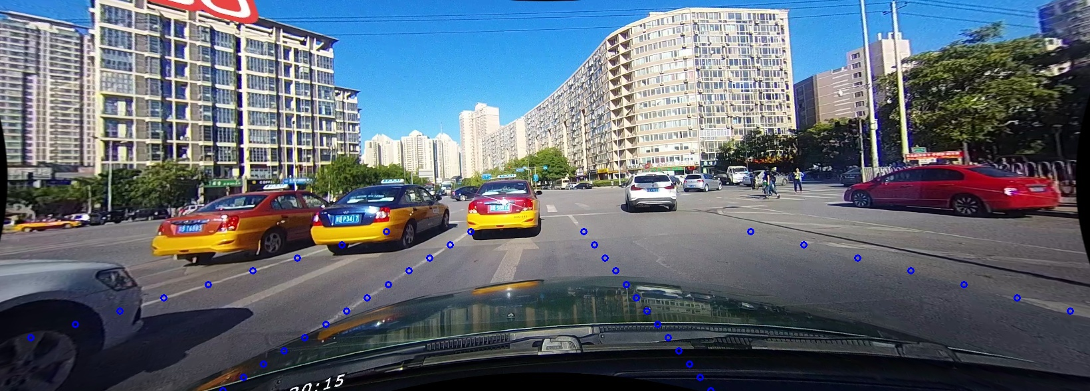
Inference Result

Slide 15
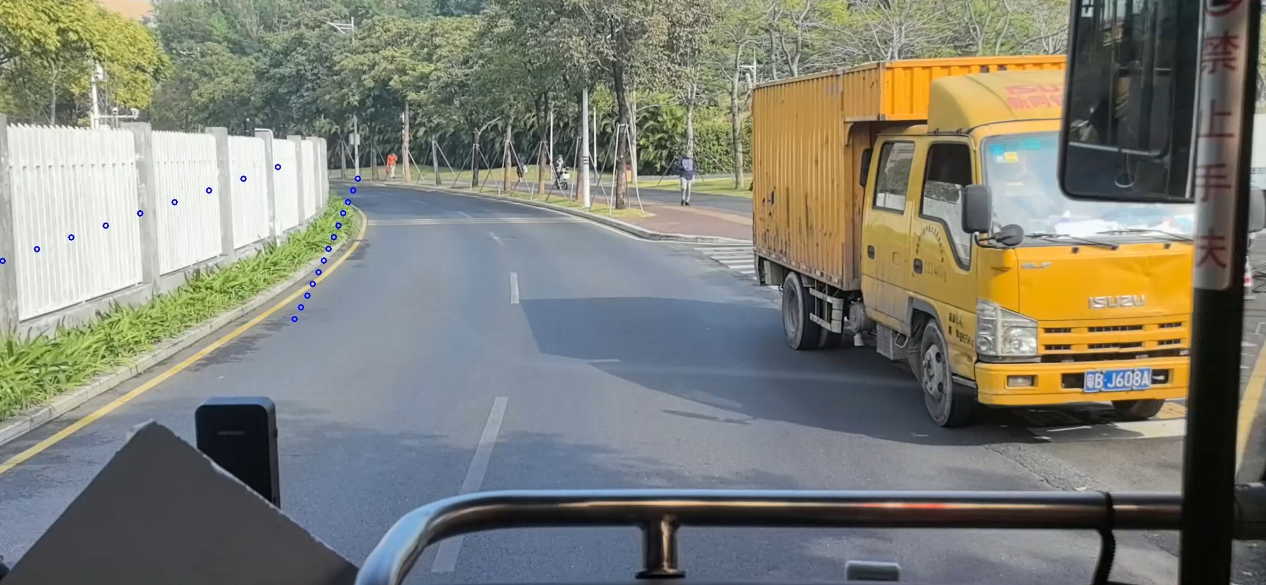
Inference Result
Notes:
取帧问题
测试问题：巴士、手持相机

Slide 16
Future Work
Data Diversity Augmentation: Increasing the diversity of training data by incorporating more variations in weather, lighting conditions, and road types can improve the model's robustness.
Cross-Domain Transfer Learning: Leveraging transfer learning could help improve the model’s ability to generalize across different domains and datasets.
Model Compression and Lightweight Architectures: Balance computation cost and generalization.

Slide 17
Conclusion
The findings of this study illustrate that modifying the feature extraction network, specifically by replacing the FPN with PAFPN, can effectively enhance the performance of the CLRNet model with only a slight impact on computational speed. As a direction for future research, efforts could be directed toward optimizing the PAFPN architecture to further reduce its computational overhead while maintaining or even enhancing the observed performance improvements

Slide 18


THANK YOU

Slide 19
Changelog
加入future work和conclusion，添加备注

